Slide 1
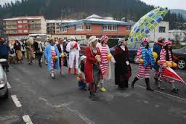
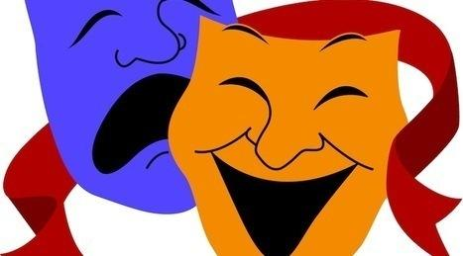
CARNIVALS IN THE BASQUE COUNTRY

Slide 2
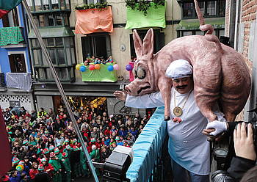
WHAT`S ABOUT?
This festival consist in dress up an to go to the party

Slide 3
BEGINNING OF THE CARNIVALS IN BASQUE COUNTRY
We didn`t know when they start exactly, but we know that this celebration is related to very old traditions of the basque towns, in particular of the rural areas.
In general this celebrations are related to religious beliefs and rites to do more productives the work in the lands, forests, with domestic animals, etc.

Slide 4
HOW IS NAMED IN THE BASQUE COUNTRY?
Depending of the region, there are different words to name this festivals:
inauteriak come from the verb "inausi" and means time to trimmed trees
ihoteak
ihauteak
aratusteak “Aharagia jateari utzi behar zaion garaia”, means time to stop eating meat

Slide 5
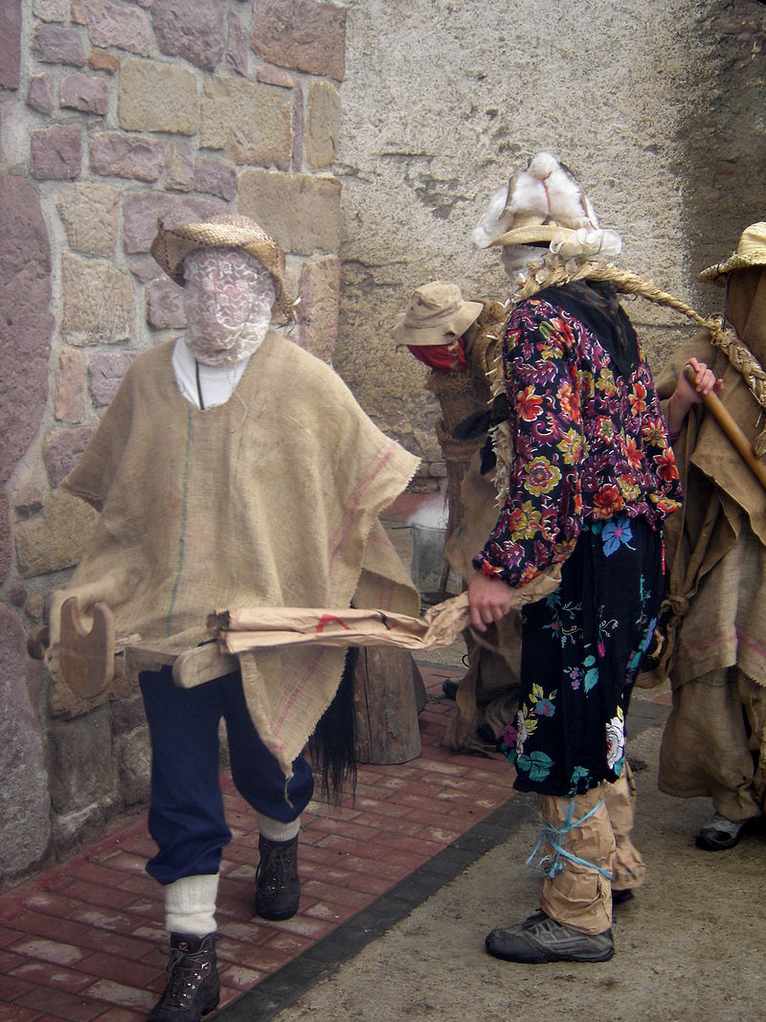
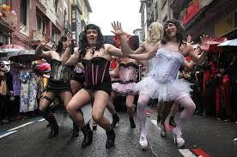
DIFFERENT WAYS TO CELEBRATE
Every town or city celebrate on his particular way, but the most importants differences depend if the festival is in the North of Basque Country (in the Francaise region) o if it is in the South Basque Country.
One of the reasons because they are differents is that during the “franquismo” the carnivals in the South of the Basque Country were prohibited. For this the carnivals of the North are more traditionals.

Slide 6
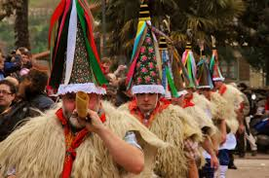
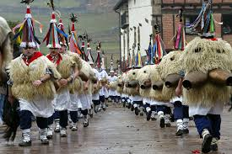
CARNIVALS IN ITUREN AND ZUBIETA (Francaise region)
When: Lask week of January
The sense of the celebration: with cowbells and whips they frightened
the beasts who atack the domestic beasts, and also frightened the evil spirits.

Slide 7
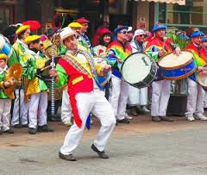
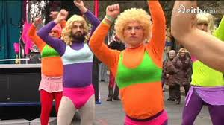
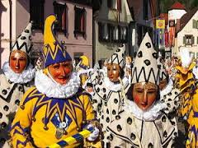
CARNIVALS IN TOLOSA
When: Beginning of February
The sense of the celebration: It is a very special and popular celebration. People of Tolosa is the protagonist. The objetive is fun.

